Slide 1
Health care stroke

Slide 2
Table of contents
01
02
03
Introduction
description
6 questions

Slide 3
introduction
we have adopted the Stroke Prediction Dataset from Kaggle which study the likelihood of a patient to get stroke based on the input parameters . predictive model of likelihood of getting Stroke could help specific high-risk group of individuals and patients to be aware of their health condition and take precaution steps to reduce the risk of getting Stroke.

Slide 4
Description of the data
ID: This variable represents a unique identifier given to each record in the stroke data, used to distinguish each participant in the study.
Gender: this variable is qualitative ,dichotomous with two categories classified into male and female
Hypertension : this variable is qualitative dichotomous with two categories ,0 if the subject doesn’t have hypertension , 1 if the subject has hypertension
Heart disease : this variable is qualitative dichotomous with two categories 0 if the subject doesn’t have heart disease , 1 if the subject have heart disease
Ever married : this variable is qualitative dichotomous with two categories ,‘yes’ indicates the participant have been married while ‘N0’ indicates otherwise
Work type : this variable is qualitative polychotomous with four categories ,children , Govet-job , never worked , private or self employed
Smoking status : this variable is qualitative polychotomous with four categories formerly smoked , never smoked , smokes , unknown
Stroke : this variable is qualitative ,dichotomous with two categories classified into 0 if subject never had a stroke , 1 if the subject suffered a stroke before

Slide 5
Age : this variable is quantitative describing the age pf the sample
Avg glucose level : this variable is quantitative describing the average glucose level in blood
BMI : this variable is quantitative describing the body mass index

Slide 6
5 types of analysis questions
Descriptive Questions: These questions seek to describe or summarize the data.
Exploratory Questions: These questions aim to discover patterns, trends, or relationships within the data
Inferential Questions: These questions try to draw conclusions or make predictions based on the data
Causal Questions: These questions seek to determine cause-and-effect relationships between variables
Predictive Questions: These questions try to predict future outcomes based on the data.

Slide 7
01
Descriptive questions

Slide 8
1) What are the key characteristics of stroke data, such as demographic information, medical history and lifestyle factors?
Demographics: age, gender, ever_married, work-type
Medical history: hyper tension, heart_disease, avg_glucose_level, bmi
Life style: smoking_status
2) What are the risk factors for stroke?
Count of stroke | hypertension
status | No | yes
No | 4428 | 432
yes | 183 | 66
Count of stroke | heart disease
status | No | yes
No | 4631 | 229
yes | 202 | 47
Count of stroke | smoking status
status | formerly smoked | never smoked | smokes | Unknown
No | 814 | 1802 | 747 | 1497
yes | 70 | 90 | 42 | 47

Slide 9
3) What is the average BMI among the sample?
4) What is the percentage of male and female among sample?
5) What is the frequency of gender across smoking status?
Average of bmi
28.91955286
gender | Count of gender
Female | 58.60%
Male | 41.40%
Grand Total | 100.00%
gender | Count of smoking_status
Female | 2994
Male | 2115
Grand Total | 5109

Slide 10
6) What is the max average glucose level?
the max average glucose level is 271.74
7) What is the average BMI and glucose level among individuals who have had a stroke?
the average BMI among the sample is 30.3631844262632
the average glucose level among sample is 132.544738955823
8) What is the percentage of individuals with hypertension and heart disease in the dataset with stroke?
status | Count of hypertension | Count of heart_disease
No | 90.25% | 90.25%
No | 86.10% | 86.10%
yes | 4.15% | 4.15%
yes | 9.75% | 9.75%
No | 8.49% | 8.49%
yes | 1.25% | 1.25%
Grand Total | 100.00% | 100.00%

Slide 11
9) How many individuals in the dataset have had a stroke? 10) What is the distribution of age, gender, BMI, and other demographic and health factors among individuals who have had a stroke?
had a stroke | Count of stroke
No | 4860
yes | 249
Grand Total | 5109
the histogram for age variable is skewed left

Slide 12
the frequency distribution of the gender shows that the female had stroke disease more than males
the histogram for BMI is normally distributed

Slide 13
the frequency distribution for hypertension among individuals who had stroke shows that individuals tested no for hypertension are more than individuals who tested yes.
the frequency distribution for heart disease among individuals who had stroke shows that individuals tested no for heart disease are more than individuals who tested yes.

Slide 14
02
Inferential
questions

Slide 15
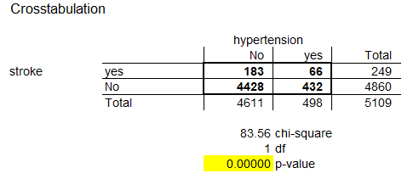
1) Can we identify potential associations between certain variables and stroke occurrence? 1) hypertension and stroke null hypothesis : hypertension is independent from stroke alternative hypothesis: hypertension is dependent from stroke
p-value <significance level
we reject null hypothesis
hypertension is dependent from stroke

Slide 16
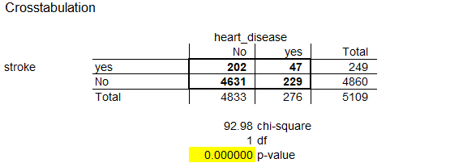
2)stroke and heart disease
null hypothesis : heart disease is independent from stroke
alternative hypothesis: heart disease is dependent from stroke
p-value <significance level
we reject null hypothesis
heart disease is dependent from stroke

Slide 17
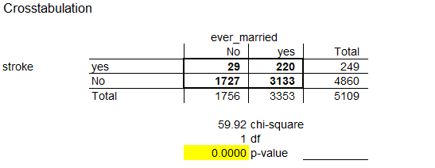
3)ever married and stroke
null hypothesis :ever married is independent from stroke
alternative hypothesis: ever married is dependent from stroke
p-value <significance level
we reject null hypothesis
ever married is dependent from stroke

Slide 18
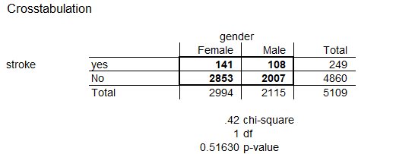
4) Gender and stroke null hypothesis :gender is independent from stroke alternative hypothesis: gender is dependent from stroke
p-value >significance level
we accept null hypothesis
gender is independent from stroke

Slide 19
2) Is there is a difference of the average BMI between gender groups?
Null hypothesis: 𝜇1 −𝜇2 = 0
Alternative hypothesis: 𝜇1 −𝜇2 ≠ 0
t-Test: Two-Sample Assuming Equal Variances
 | Female BMI | Male BMI
Mean | 29.0858496 | 28.68414272
Variance | 63.97200118 | 53.70941972
Observations | 2994 | 2115
Pooled Variance | 59.72389129
Hypothesized Mean Difference | 0
df | 5107
t Stat | 1.829988474
P(T<=t) one-tail | 0.03365496
t Critical one-tail | 1.64515205
P(T<=t) two-tail | 0.06730992
t Critical two-tail | 1.960428606
since: t-crit two-tail > t-stat
Therefore: accept null hypothesis
Therefore: there is no difference between the means of the Gender and BMI variables

Slide 20
2)Is there a difference of mean BMI with different work type
null hypothesise : there is no difference in all group
alternative hypothesis :at least two groups are have different means
ANOVA
Source of Variation | SS | df | F | P-value | F crit
Between Groups | 48733.41909 | 4 | 554.938222 | 0 | 2.375181607
Within Groups | 60045.37799 | 2735
Total | 108778.7971 | 2739
since p-value < 0.05 we can conclude that at least two groups have different mean

Slide 21
3) What is the accuracy of logistic regression algorithms in predicting stroke risk? Hypothesis test: H0: there is no association between the stroke and the respond H1: there is an association between the stroke and the respond p-values will be used for assessing the logistic regression model. A significance level of 0.05 indicates a 5% risk of concluding that an association exists when there is no actual association. P-value ≤ α: The association is statistically significant P-value > α: The association is not statistically significant

Slide 22
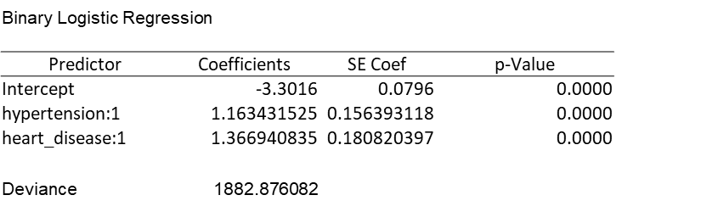
1) predictors of stroke : hypertension and heart disease
Hypertension
P-value (0) ≤ 0.05: There is a significant statistical association
The decision: Reject H0
Therefore: There is an association between the hypertension and stroke
heart disease
P-value (0) ≤ 0.05: There is a significant statistical association
The decision: Reject H0
Therefore: There is an association between the heart disease and stroke
since: hypertension and heart disease variables are categorical
Therefore: The probability of stroke differ among the variable records

Slide 23
2) predictors of stroke : ever married , avg glucose level , bmi , smoking status
Binary Logistic Regression
Predictor | Coefficients | SE Coef | p-Value
Intercept | -4.8114 | 0.3137 | 0.0000
ever_married:1 | 1.238402292 | 0.210170851 | 0.0000
avg_glucose_level | 0.008628699 | 0.001155893 | 0.0000
bmi | -0.008520293 | 0.009638358 | 0.3767
smoking_status:1 | 0.299227214 | 0.134676722 | 0.0263
Deviance | 1861.807467
ever_married
avg_glucose_level
Bmi
smoking_status
P-value (0) ≤ 0.05: There is a significant statistical association | The decision: Reject H0 | Therefore: There is an association between the ever_married and stroke
P-value (0) ≤ 0.05: There is a significant statistical association | The decision: Reject H0 | Therefore: There is an association between the avg_glucose_level and stroke
P-value (0) > 0.05: There is no significant statistical association | The decision: Accept H0 | Therefore: There is no association between the bmi and stroke
P-value (0) ≤ 0.05: There is a significant statistical association | The decision: Reject H0 | Therefore: There is an association between the smoking- status and stroke
since: The ever_married and smoking_status are categorical
Therefore: The propability of stroke differ among the variable records
since: The bmi is continous
Therefore: the coefficient of the variable is zero

Slide 24
3) predictors of stroke: gender and age
Binary Logistic Regression
Predictor | Coefficients | SE Coef | p-Value
Intercept | -7.1678 | 0.3430 | 0.0000
gender:1 | -0.11530853 | 0.13736143 | 0.4012
age | 0.074773198 | 0.004930231 | 0.0000
Deviance | 1615.543332
Therefore: There is no association between the age and stroke since: The age is continous Therefore: the coefficient of the variable is zero
Therefore: There is an association between the gender and stroke since: The gender is categorical Therefore: The probability of stroke differ among the variable records
P-value (0) > 0.05: There is no significant statistical association
P-value (0) ≤ 0.05: There is a significant statistical association
age
gender

Slide 25
03
exploratory
questions

Slide 26
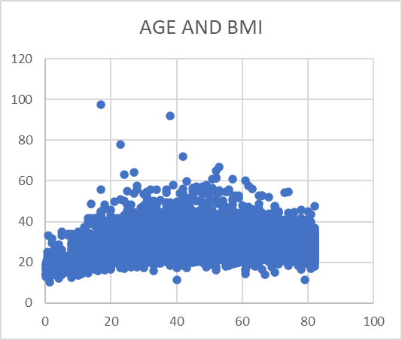
1) Is there is a pattern between age and BMI?
2) what is the relationship between BMI and average glucose level?
correlation between the two variables is weak positive relationship at a value =0.172306896865273
positive weak relationship at correlation =0.33474

Slide 27
3) what is the association between smoking status and gender?
Crosstabulation
 |  |  | smoking_status
 |  |  | Unknown | never smoked | smokes | formerly smoked | Total
gender | Female |  | 836 | 1229 | 452 | 477 | 2994
 | Male |  | 708 | 663 | 337 | 407 | 2115
 | Total |  | 1544 | 1892 | 789 | 884 | 5109
 |  |  | .101 | Phi coefficient
 |  |  | .101 | Coefficient of Contingency
 |  |  | .101 | Cramér's V
 |  |  | weak relationship

Slide 28
4) Are there any patterns or relationships in the quantitative data that can provide insights into the risk factors or early indicators of stroke?
5) Can we identify potential associations between certain Qualitative variables and stroke occurrence?
1)hypertension and stroke
stroke and age | 0.245239
bmi and stroke | 0.042277
glucose and stroke | 0.131991
Positve weak relation | biserial correlation = 0.245215
Positive weak relation | biserial correlation = 0.042273
Positive weak relation | biserial correlation = 0.131978
since the biserial is positive the respondent of (0) has lower age values than (1)
since the biserial is positive the respondent of (0) has lower bmi values than (1)
since the biserial is positive the respondent of (0) has lower bmi values than (1)
Crosstabulation
 |  |  | hypertension
 |  |  | No | yes | Total
stroke | No |  | 4428 | 432 | 4860
 | yes |  | 183 | 66 | 249
 | Total |  | 4611 | 498 | 5109
.128 | Phi coefficient
.127 | Coefficient of Contingency
.128 | Cramér's V
weak relationship between hypertension and stroke

Slide 29
2) heart disease and stroke
3)ever married and stroke
Crosstabulation
 |  |  | heart_disease
 |  |  | No | yes | Total
stroke | No |  | 4631 | 229 | 4860
 | yes |  | 202 | 47 | 249
 | Total |  | 4833 | 276 | 5109
.135 | Phi coefficient
.134 | Coefficient of Contingency
.135 | Cramér's V
weak relationship between hypertension and stroke
Crosstabulation
 |  |  | ever_married
 |  |  | No | yes | Total
stroke | No |  | 1727 | 3133 | 4860
 | yes |  | 29 | 220 | 249
 | Total |  | 1756 | 3353 | 5109
.108 | Phi coefficient
.108 | Coefficient of Contingency
.108 | Cramér's V
weak relationship between ever married and sroke

Slide 30
4) smoking status and stroke
5) gender and stroke
Crosstabulation
 |  |  | smoking_status
 |  |  | Unknown | never smoked | smokes | formerly smoked | Total
stroke | No |  | 1497 | 1802 | 747 | 814 | 4860
 | yes |  | 47 | 90 | 42 | 70 | 249
 | Total |  | 1544 | 1892 | 789 | 884 | 5109
.076 | Phi coefficient
.075 | Coefficient of Contingency
.076 | Cramér's V
weak relationship between smoking status and stroke
Crosstabulation
 |  |  | gender
 |  |  | Female | Male | Total
stroke | No |  | 2853 | 2007 | 4860
 | yes |  | 141 | 108 | 249
 | Total |  | 2994 | 2115 | 5109
.009 | Phi coefficient
.009 | Coefficient of Contingency
.009 | Cramér's V
weak relationship between gender and stroke

Slide 31
04
predictive
questions

Slide 32
1) Predict stroke based on the variables included in the data 2) Can we identify the most influential risk factors for stroke prediction? 1) predictors of stroke : hypertension , heart disease
Binary Logistic Regression
Predictor | Coefficients | SE Coef | Z | p-Value
Intercept | -3.3016 | 0.0796 | -41.4819 | 0.0000
hypertension:1 | 1.1634315 | 0.156393 | 7.439148 | 0.0000
heart_disease:1 | 1.3669408 | 0.18082 | 7.559661 | 0.0000
Deviance | 1882.8761
equation Y=-3.30159+1.1634X +1.3669X2
since positive coefficients indacates that the stroke becomes more likely to accur as the hypertension and heart disease increase

Slide 33
2) predictors of stroke : ever married , avg glucose level ,bmi, smoking status
Binary Logistic Regression
Predictor | Coefficients | SE Coef | Z | p-Value
Intercept | -4.8114 | 0.3137 | -15.3370 | 0.0000
ever_married:1 | 1.2384023 | 0.210171 | 5.89236 | 0.0000
avg_glucose_level | 0.0086287 | 0.001156 | 7.464961 | 0.0000
bmi | -0.0085203 | 0.009638 | -0.884 | 0.3767
smoking_status:1 | 0.2992272 | 0.134677 | 2.221818 | 0.0263
Deviance | 1861.8075
equation Y=-4.8114 +1.238X1 +0.0086X2 -0.00852X3 +0.2992X4 positive
coefficients indacates that the stroke becomes more likely as the ever married ,avg glucose level and smoking status increase
Negative coefficients indicate that the stroke becomes less likely as the bmi increases.

Slide 34
3) predictors of stroke: gender and age
Binary Logistic Regression
Predictor | Coefficients | SE Coef | Z | p-Value
Intercept | -7.1678 | 0.3430 | -20.8957 | 0.0000
gender:1 | -0.1153085 | 0.137361 | -0.83945 | 0.4012
age | 0.0747732 | 0.00493 | 15.16627 | 0.0000
Deviance | 1615.5433
equation Y=-7.1677 -0.1153X1 +0.07477X2
positive coefficients indacates that the stroke becomes more likely as the age increase
Negative coefficients indicate that the stroke becomes less likely as the gender increases.
after the analysis and based on the cofficients of logistic regression
the most influential risk factor based on the largest cofficient in decending order is
1)heart disease
2)ever married
3)hypertension
4)smoking status
5)age
6) avg glucose level
the rest factors don’t affect on the prediction of stroke

Slide 35
Our team
Ganna allah assaad
204115
214091
214100
214123
Toka alsayed
Wessam mohamed
Mariam mohamed

Slide 36
Thanks

